Slide 1
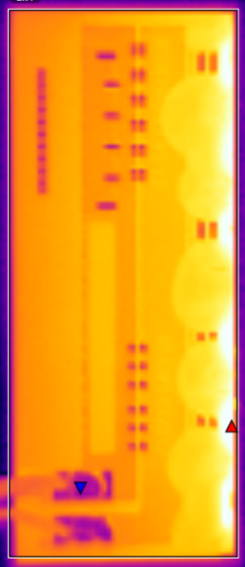
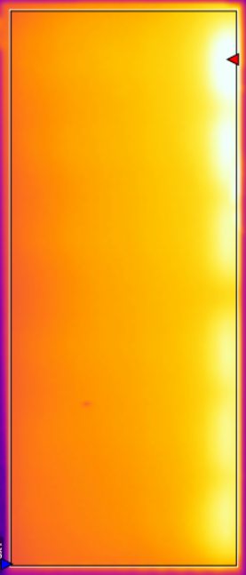
IR Maps of Front and Back of Module Suspended in Air
Front
Back
Both images taken at 2.5W for 40 minutes from 4 inches using IR camera
Modules positioned vertically
Temperature comparisons:
 | Front | Back
Minimum | 26.1ºC | 46.1ºC
Maximum | 64.0ºC | 67.3ºC
Average | 48.5ºC | 53.7ºC

Slide 2
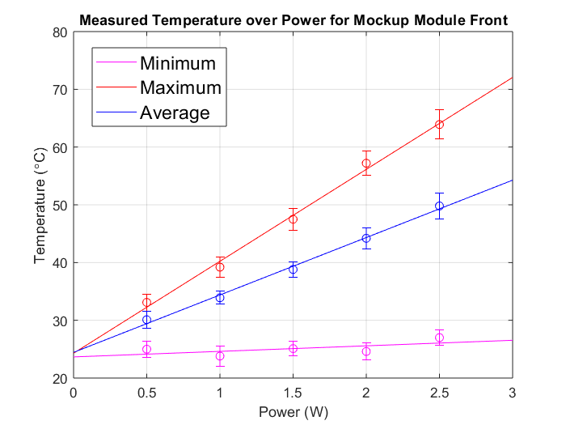
Temperature over Power of Module Front Suspended in Air
Min, max, and avg T of the front of one module, recorded three times for 0.5, 1, 1.5, 2, and 2.5 watts
ΔT/ΔW Slopes (Y=mx+b) allow for temperature extrapolation
Min: 0.96
Max: 15.92
Avg: 9.94

Slide 3
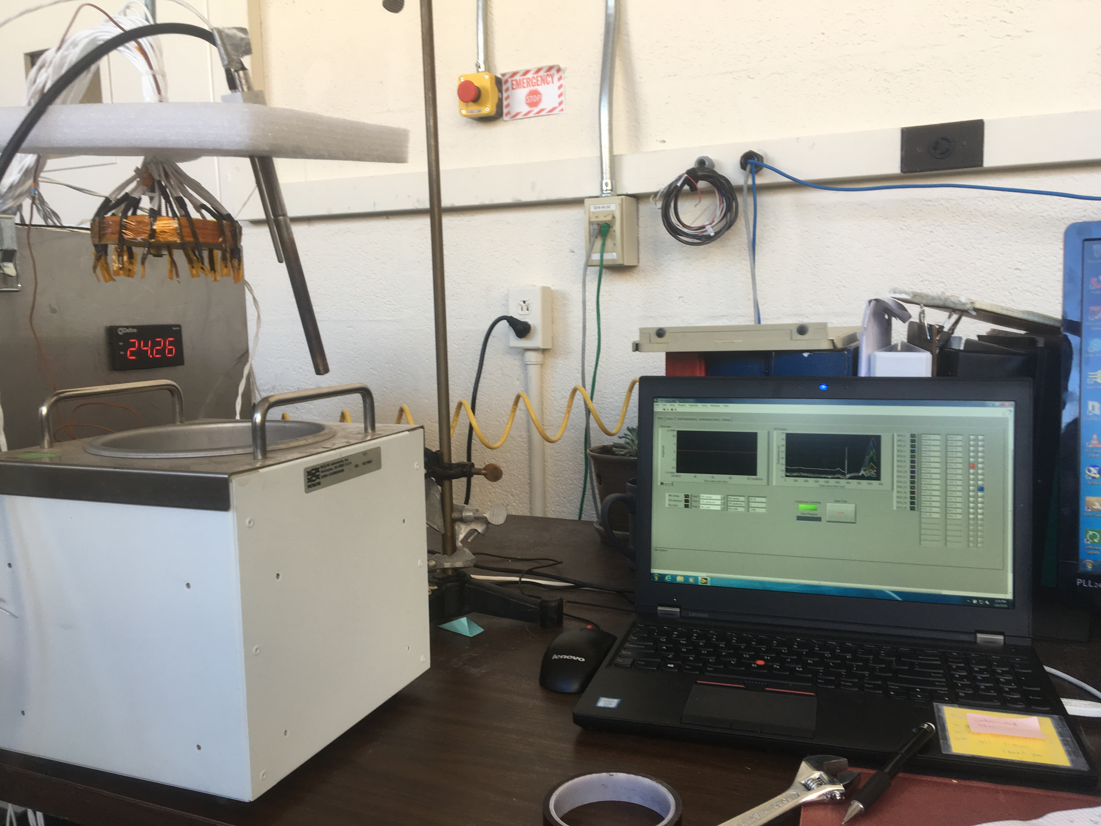
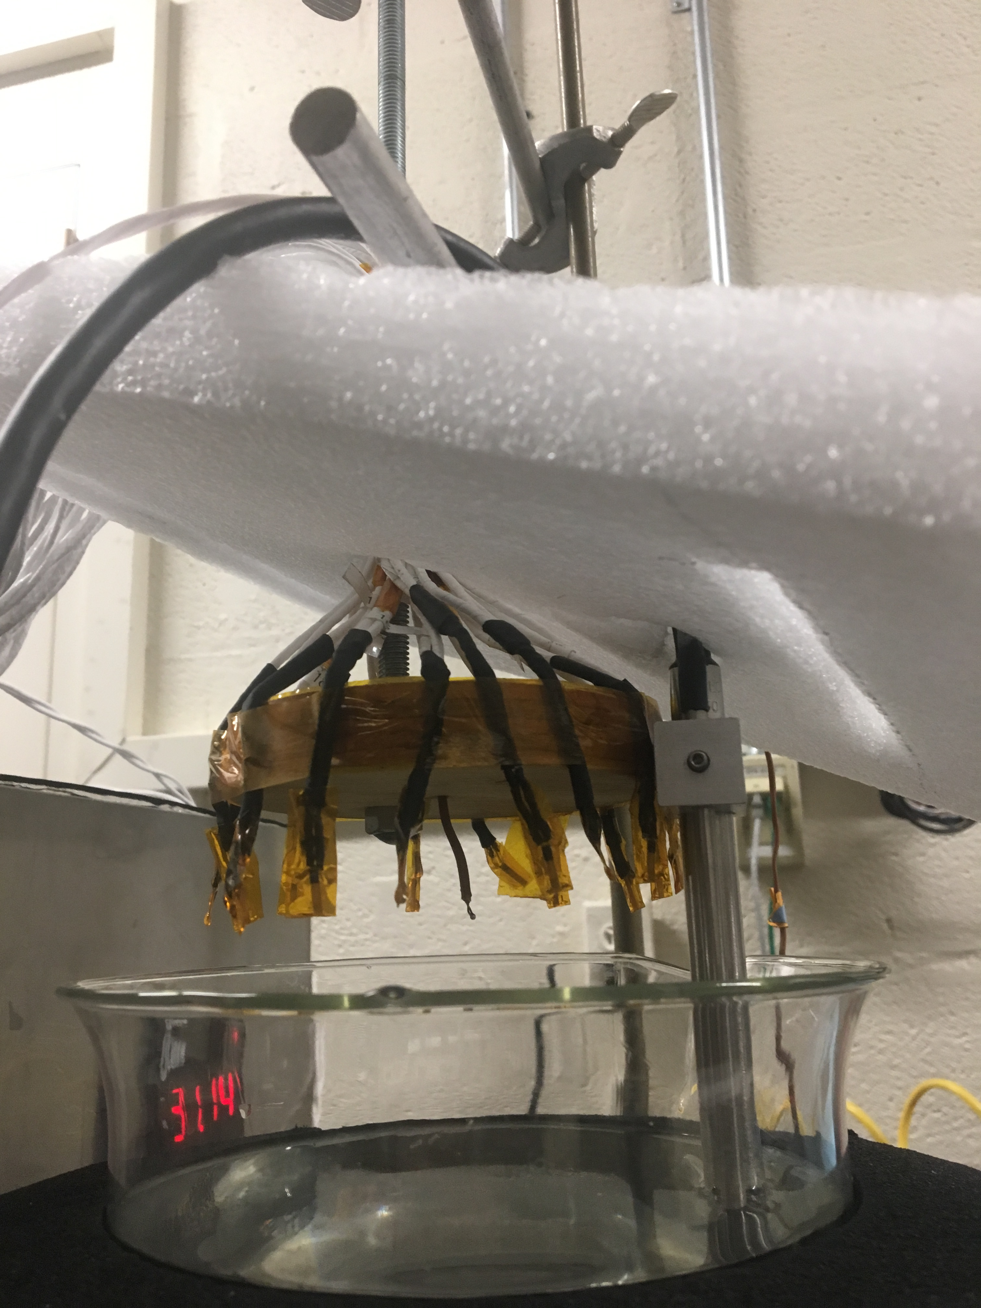
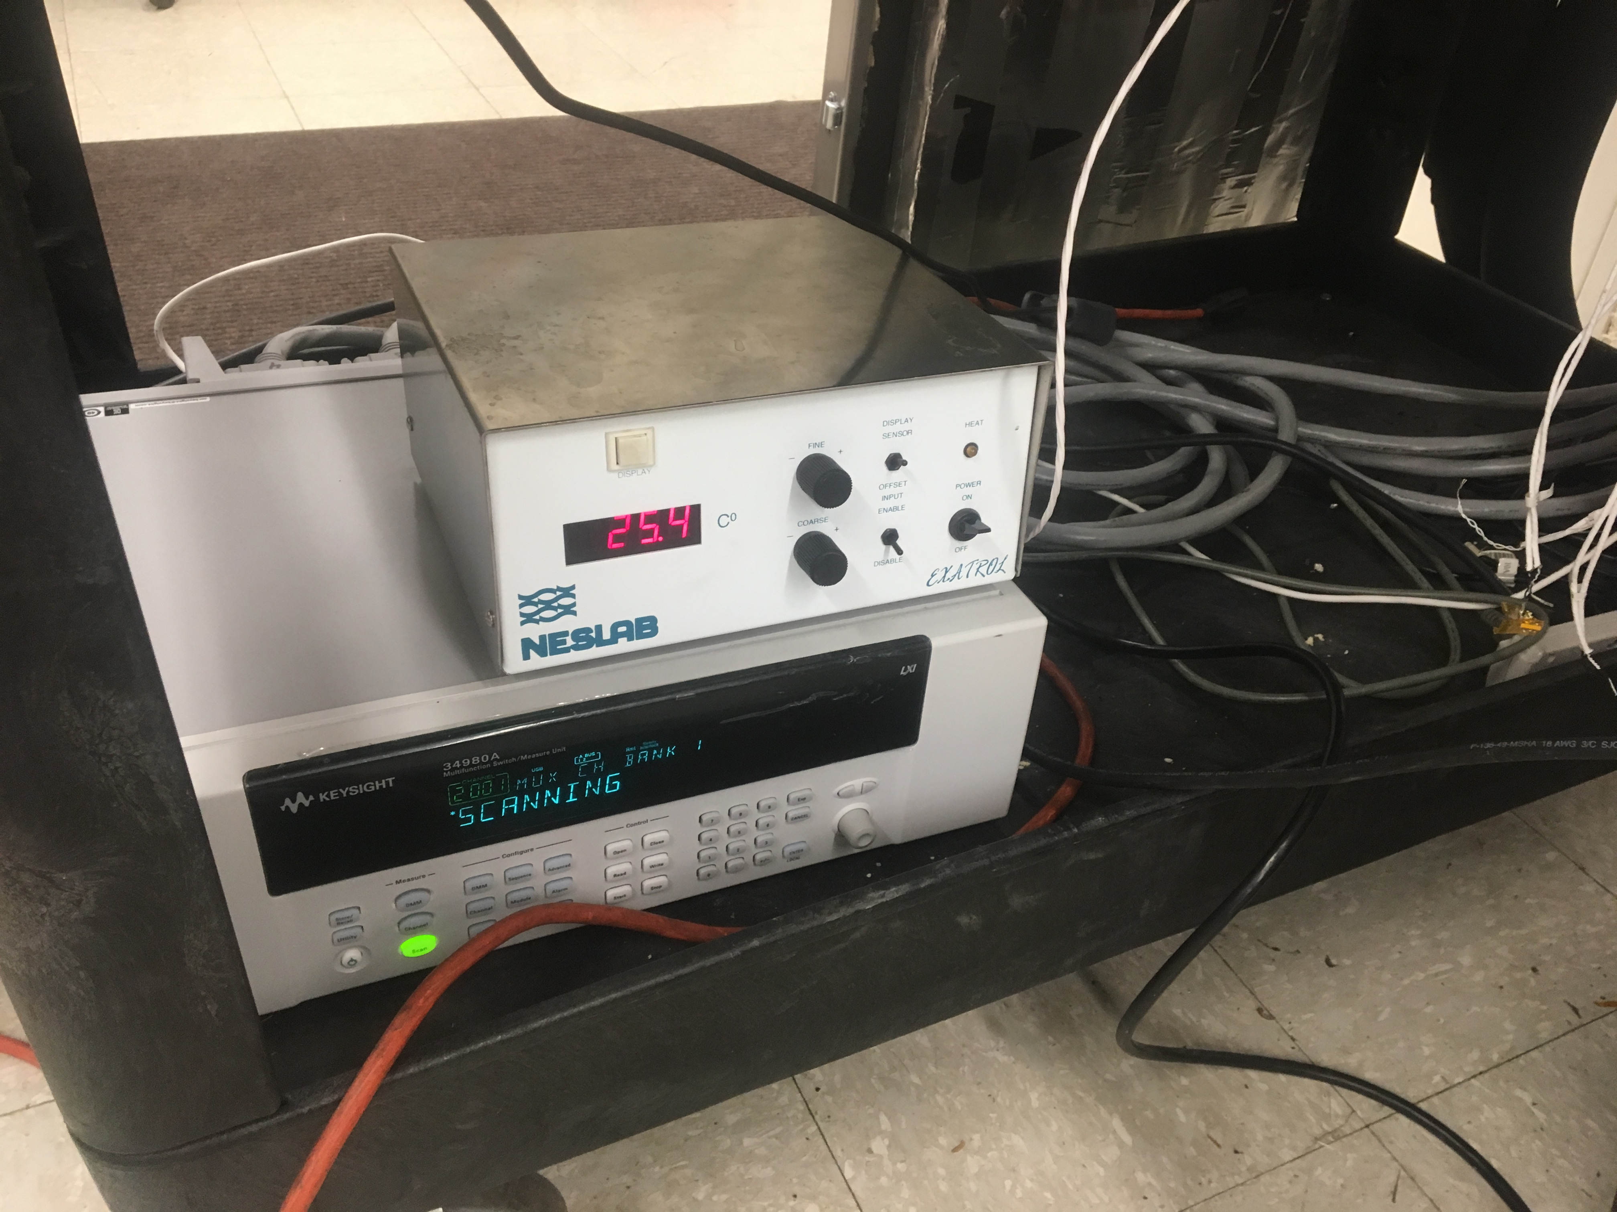
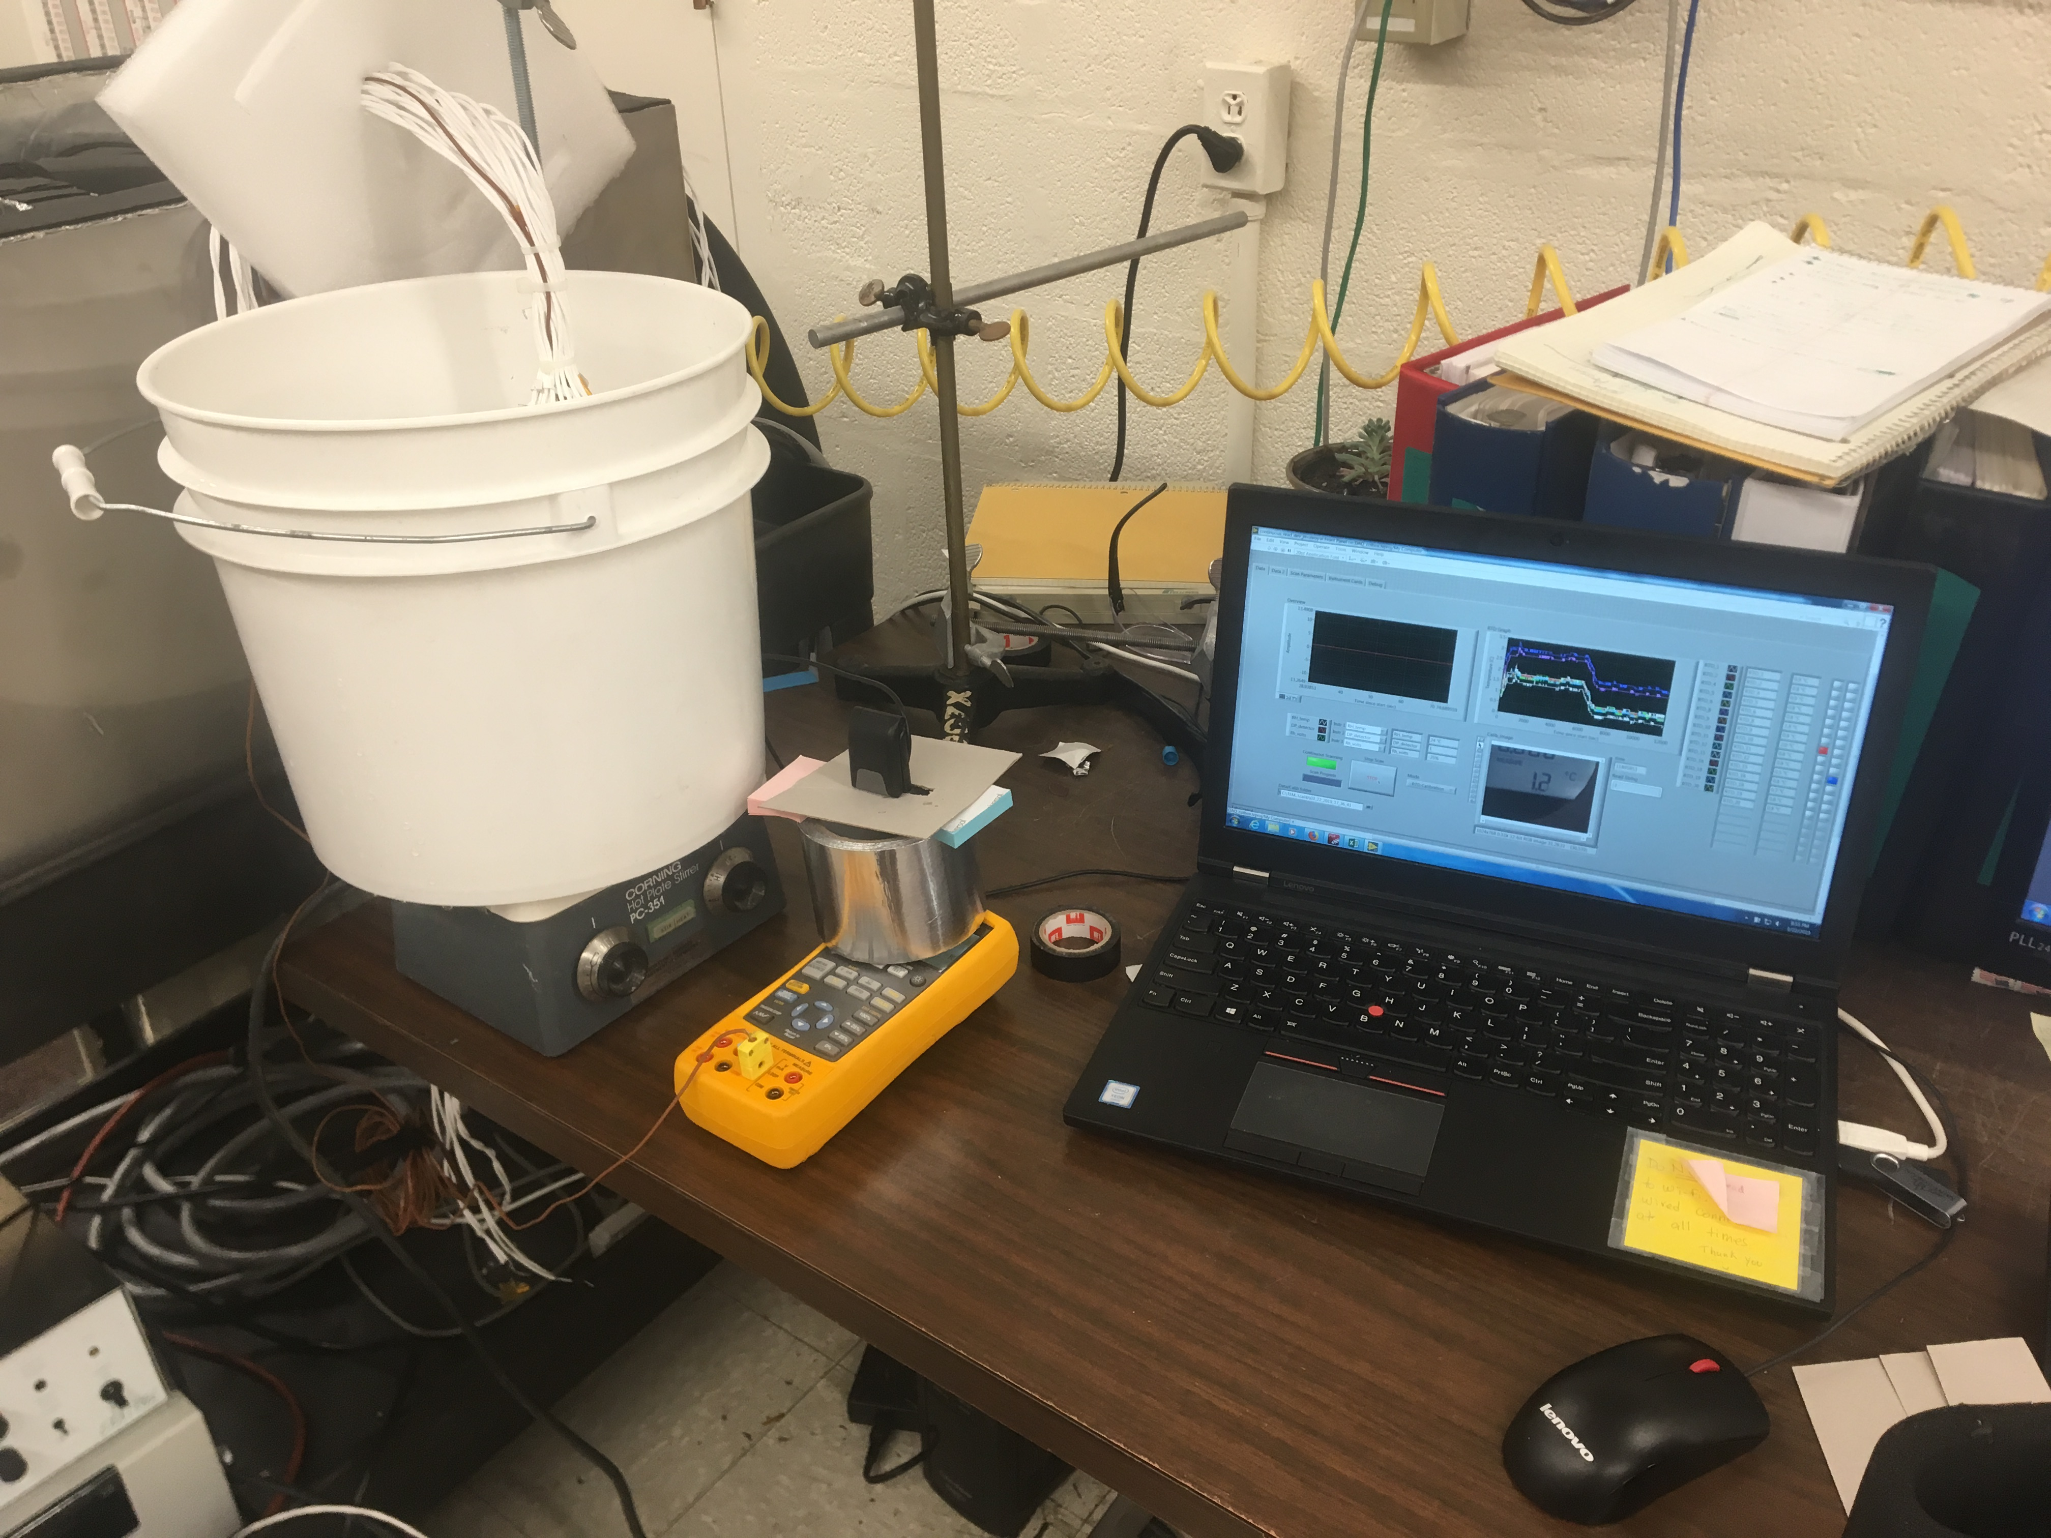
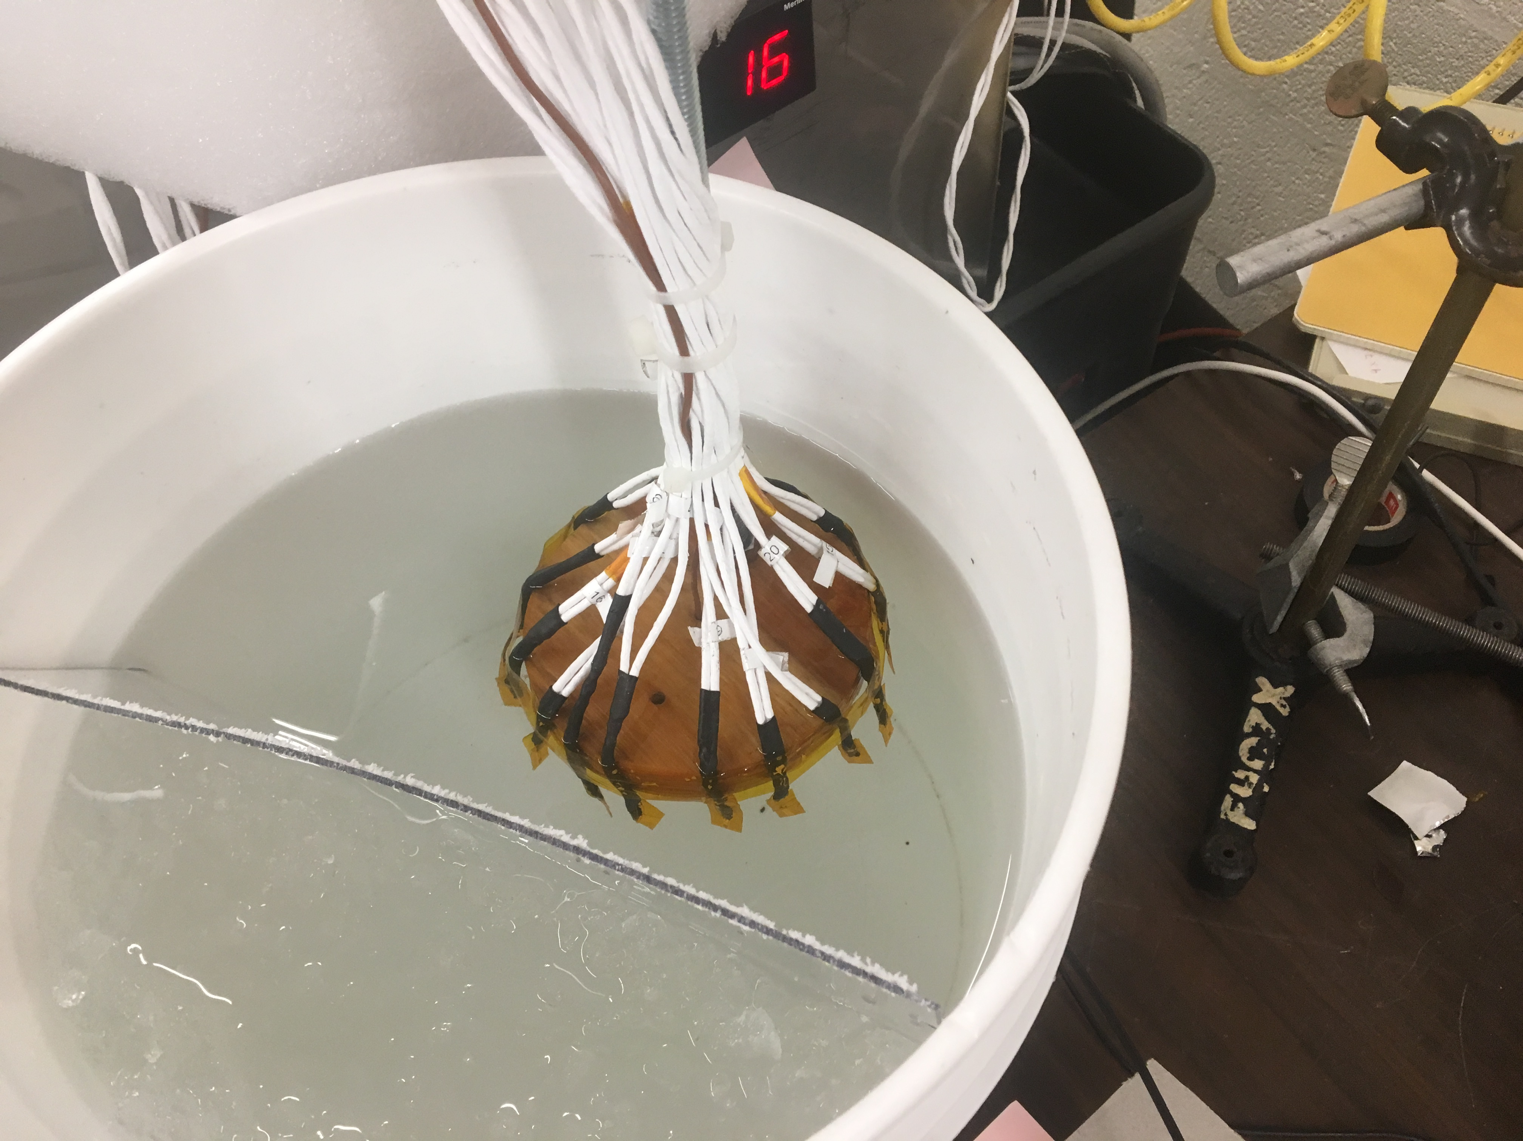
Coldbox RTDs Calibration
RTDs Calibration setup (FLUKE E50 calibrator)
KEYSIGHT 34980A datalogger
3-5 steady-state temperatures
Calibration curves for each RTD

Slide 4
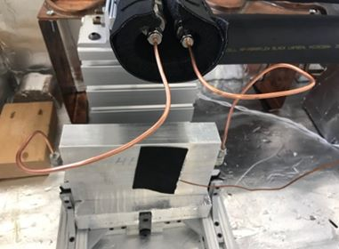
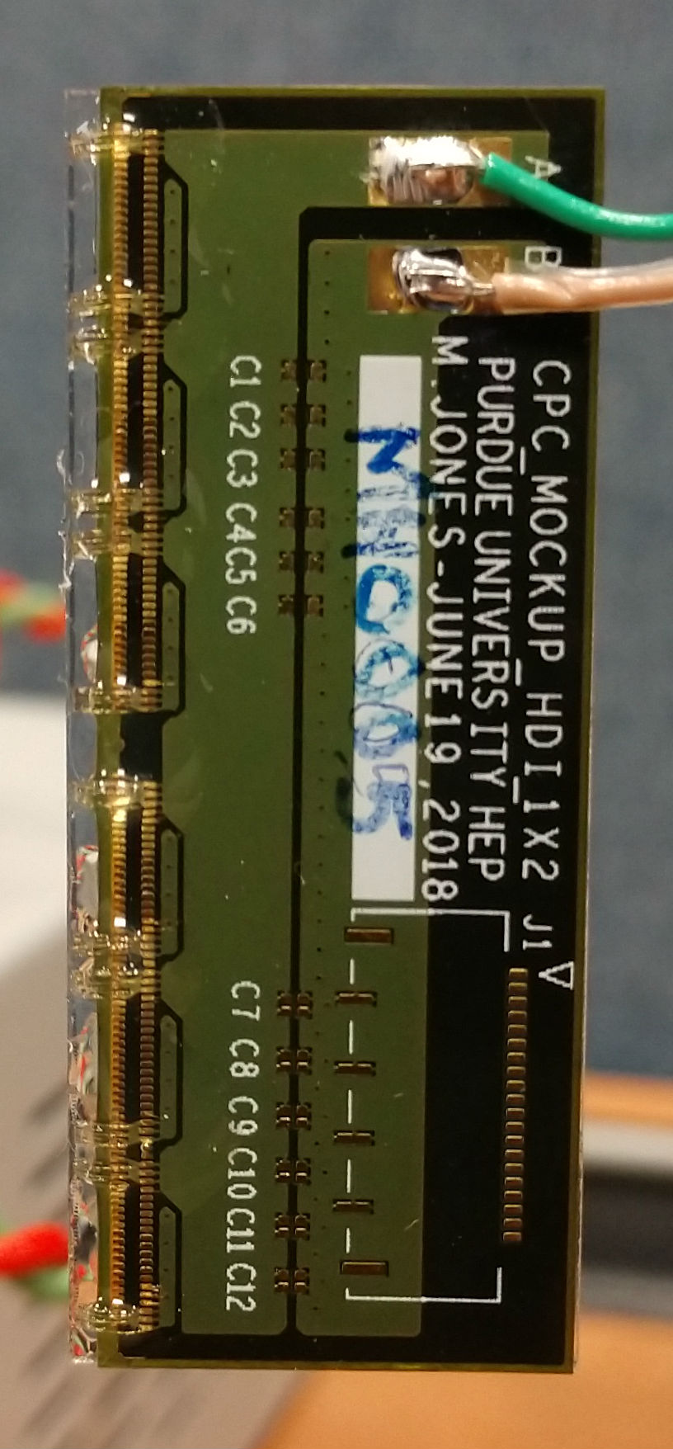
Mockup module testing with CO₂
Mockup-modules (M) attached to an aluminum block-CO₂ flow (heat sink S)
Several config. backing materials: S-M, S-graphite-M, S-Laird-M CF-M, CF-Cf-M, …
Several orientations w.r.t. cooling line
Carbon fiber(CF), Carbon foam (Cf)

